Slide 1



Working with Actions
NHS Automation Team

Slide 2
Action Toolbar
Working with Actions
The Action List enables us to view either the entire test flow
An action view displays all the details of the selected reusable or external action.
In the Expert View, the Action List is always visible and the Expert
View always displays the script for the selected action.
Action Toolbar Consist of :
1. Non-Reusable action
2. Reusable action
3. External action

Slide 3
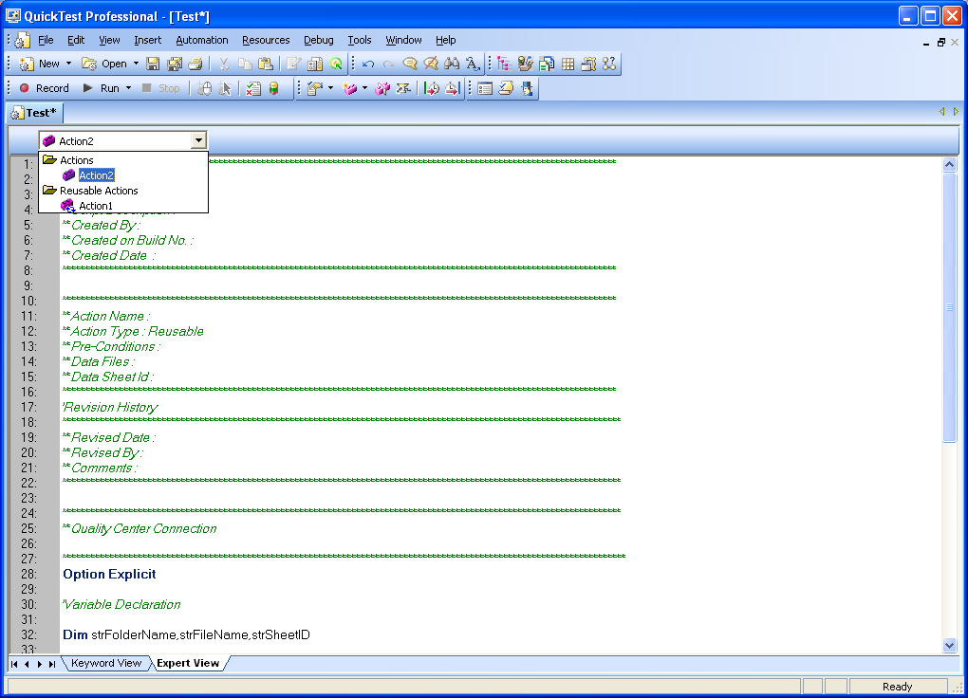
Action Toolbar (Contd…)
Working with Actions

Slide 4
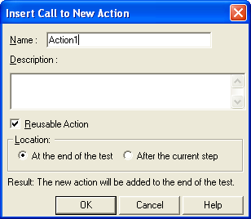
Creating New Actions
Working with Actions
To create a new action in your test:
  choose Insert > Call to New Action or click the Insert Call to New Action button.
  The Insert Call to New Action dialog box opens.
  Type a new action name or accept the default name.

Slide 5
Creating New Actions (Contd…)
Working with Actions
5.Select Reusable Action if you want to be able to call the action from other tests or multiple times from within this test.
6.Decide where to insert the call to the action by selecting At the end of the test or After the current step.
7.Click OK. A new action is stored with your test.

Slide 6
Inserting Calls to Existing Actions
Working with Actions
An Action can be called from another action in two ways
Call to existing Action
You can insert a call to a reusable action that is stored in your current test (local action), or in any other test (external action). Inserting a call to an existing action is similar to linking to it. You can view the steps of the action in the action view, but you cannot modify them. The called action's local object repository (if it has one) is also read-only.
Choose Insert > Call to Existing Action, right-click an action icon and select Insert Call to Existing Action, or right-click any step and select Action > Insert Call to Existing to Insert call to an Existing action.

Slide 7
Inserting Calls to Existing Actions
Working with Actions
2. Call to Copy of Action
When you insert a call to a copy of an action into a test, the original action is copied in its entirety, including checkpoints, parameterization, the corresponding action tab in the Data Table, plus any defined action parameters. If the test you are copying has objects in the local object repository, the copied action's local object repository is also copied together with the action.
choose Insert > Call to Copy of Action, right-click an action icon and select Insert Call to Copy of Action, or right-click any step and select Action > Insert Call to Copy to Insert a Call to copy of an action

Slide 8
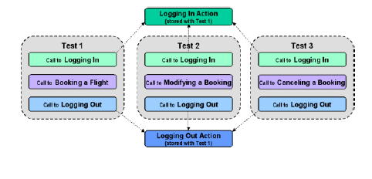
Inserting Calls to Existing Actions
Working with Actions
Example: Here we can use Login and Logout Actions as reusable actions for Test1, Test2, Test3.

Slide 9
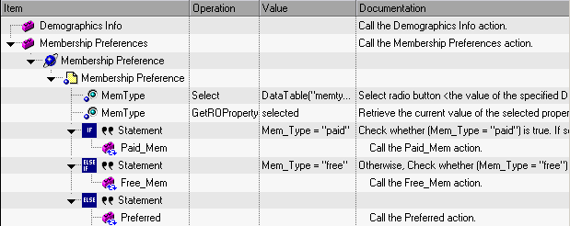
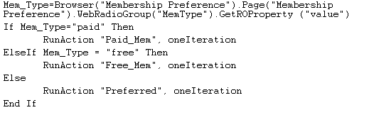
Nesting Actions
Working with Actions
Usage of one action in another action, In the Keyword View :
In Expert View

Slide 10
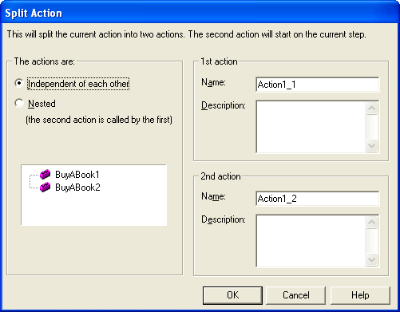
Splitting Actions
Working with Actions
We can split an action that is stored with your test into two sibling
actions or into parent-child nested actions.
To split an action:
1. Select the step before which you want the new (second) action
to begin.
2. Choose Step > Split Action, click the Split Action button, or right-click the step and choose Action > Split. The Split Action dialog box opens.

Slide 11
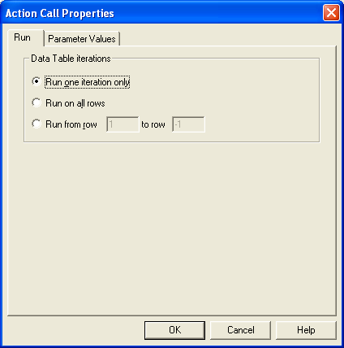
Setting Action Call Properties
Working with Actions
The Action Call Properties dialog box controls the way the action behaves in a specific call to the action. It enables you to specify how many times QuickTest should run the called action
Open the Action Call Properties dialog box while recording or editing a test by:
Choosing Edit > Action >Action Call Properties from the Keyword View when an action node is highlighted.
Right-clicking an action node in the Keyword View and selecting Action Call Properties.

Slide 12
Parameterising Actions
Working with Actions
You can specify input parameters for an action so that steps in the action can use values supplied from elsewhere in the test.
Input values for an action parameter can be retrieved from the test (for a top level action) or from the parameters of the action that calls it
We can specify output parameters for an action, so that it can return values for use later in the test.
The actual input and output action parameters that an action can receive or return, and their types, are defined in the Action Properties dialog box.
An action call with parameters has the following syntax:
RunAction ActionName, IterationQuantity, Parameters

Slide 13
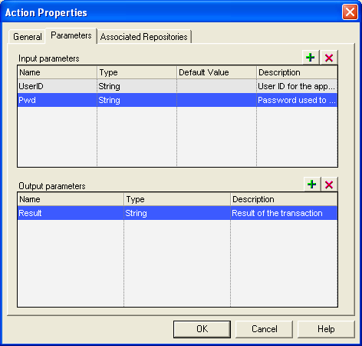
Parameterising Actions
Working with Actions
Choose Edit > Action > Action Properties and select the Parameter
Values Tab.
To add a new input or output action parameter:
1. Click the Add button next to the Input parameters or Output parameters

Slide 14
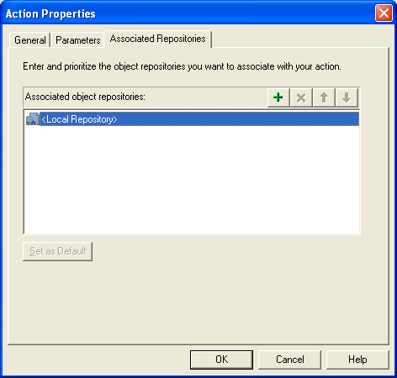
Associating Object Repositories to Actions
Working with Actions
Choose Edit > Action > Action Properties and select the Associated
Repositories Tab.
To associate an Object Repository:
1. Click on the Add button next to the Associated Object
Repositories section

Slide 15
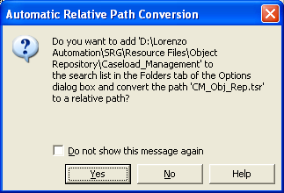
Associating Object Repositories to Actions
Working with Actions
2. Choose the Object Repository to be associated. Choose ‘Yes’ in the Dialog that appears if you want to add the Object Repository path to the List of Relative Paths under Tools > Options > Folders. Choose ‘No’ if you do not want to add the path as a relative path.

Slide 16
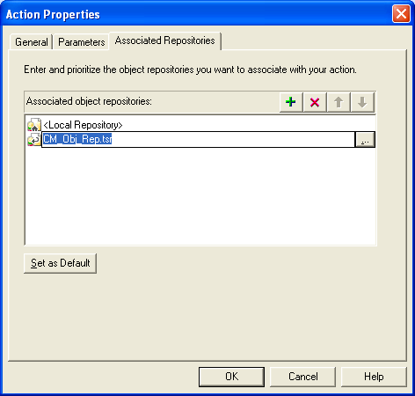
Associating Object Repositories to Actions
Working with Actions
3. After Choosing the Object Repository to be associated, Click on the OK
button.

Slide 17
Exiting an Action
Working with Actions
We can add a line in your script in the Expert View to exit an action before
it runs in its entirety.
ExitAction - Exits the current action, regardless of its iteration
attributes.
ExitActionIteration - Exits the current iteration of the action.
ExitRun - Exits the test, regardless of its iteration attributes.
ExitGlobalIteration - Exits the current global iteration.

Slide 18
Sharing Action Information
Working with Actions
There are several ways to share or pass values from one action to other
actions:
  Store values in the output action parameters of a called action and use those values in steps that are performed after the action call within the calling action.
  Store values from one action in the global Data Table and use these values as Data Table parameters in other actions.
  Set a value from one action as a user-defined environment variable and then use the environment variable in other actions.

Slide 19
Summary of the Topics Covered
Working with Actions
Action Toolbar
Creating New Actions
Inserting Calls to Existing Actions
Nesting Actions
Splitting Actions
Setting Action Call Properties
Parameterising Actions
Associating Object Repositories to Actions
Exiting an Action
Sharing Action Information
Questions?

Slide 20

Thank You

